Slide 1

COMP2021 GROUP3 command-line TMS PROJECT
Group members:
22106753d Xiang Muze
22079056d HUANG YUI HEI
22076162D Tai Lee Na
22079086D hon bing yui

Slide 2
Introduction
TMS (command-line Task management system):
Highly robust and flexible architecture
Functionalities include task creation, modification, and querying
focuses on object-oriented principles
Effective use of design patterns, data structures, and coding best practices
Follows the Model-View-Controller (MVC) paradigm
Modular design for scalability and maintainability

Slide 3
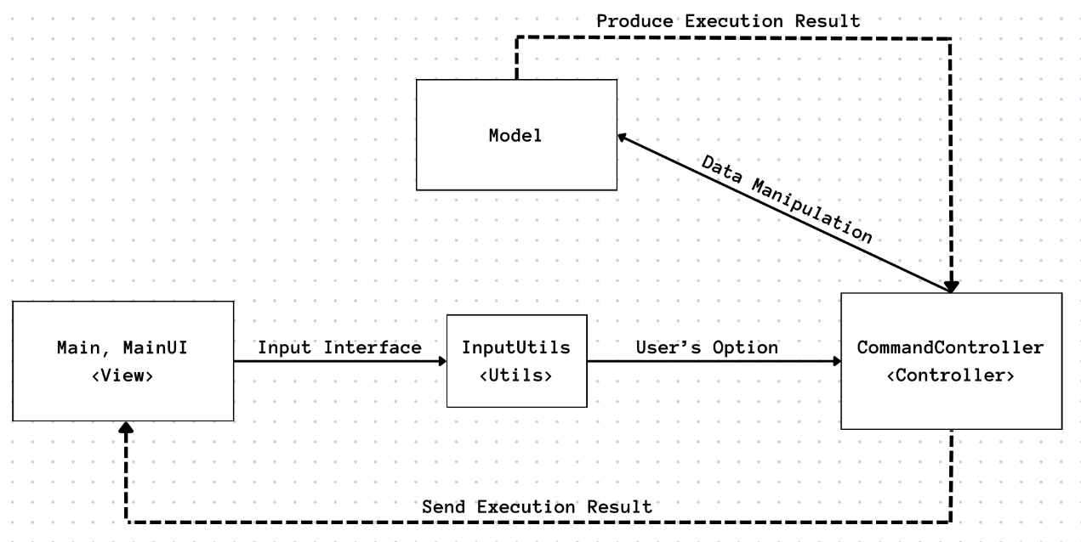
System Architecture

Slide 4
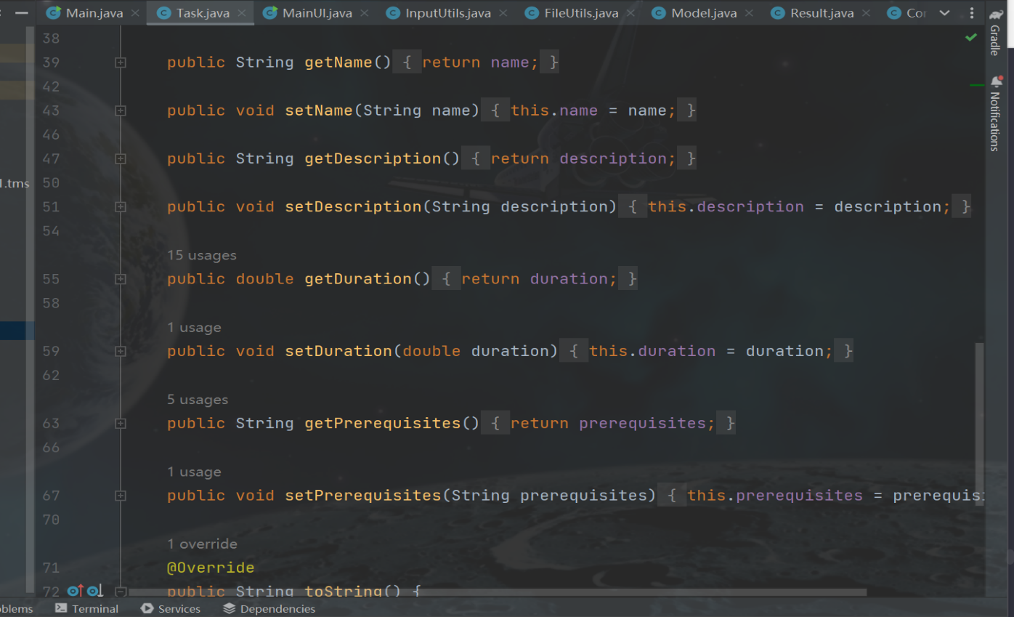
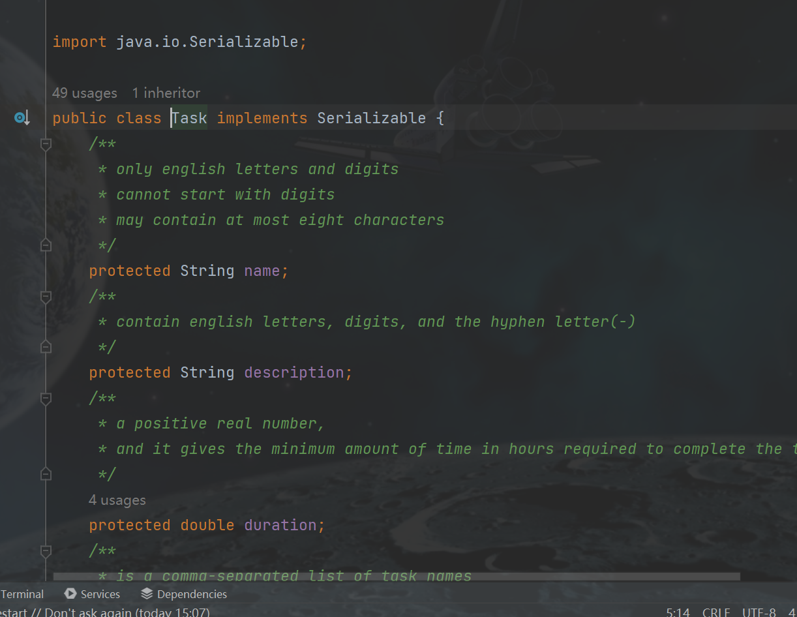
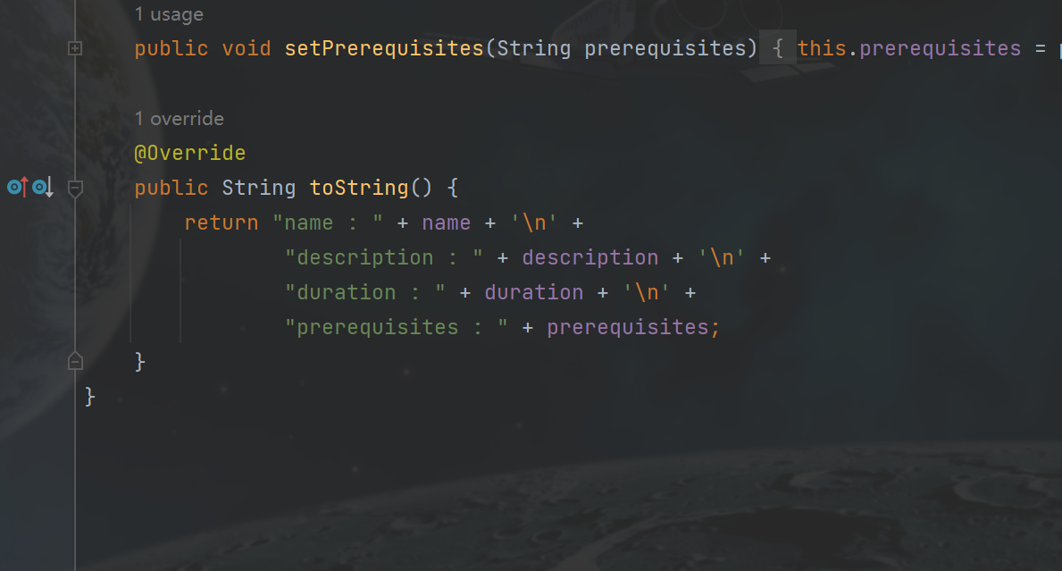
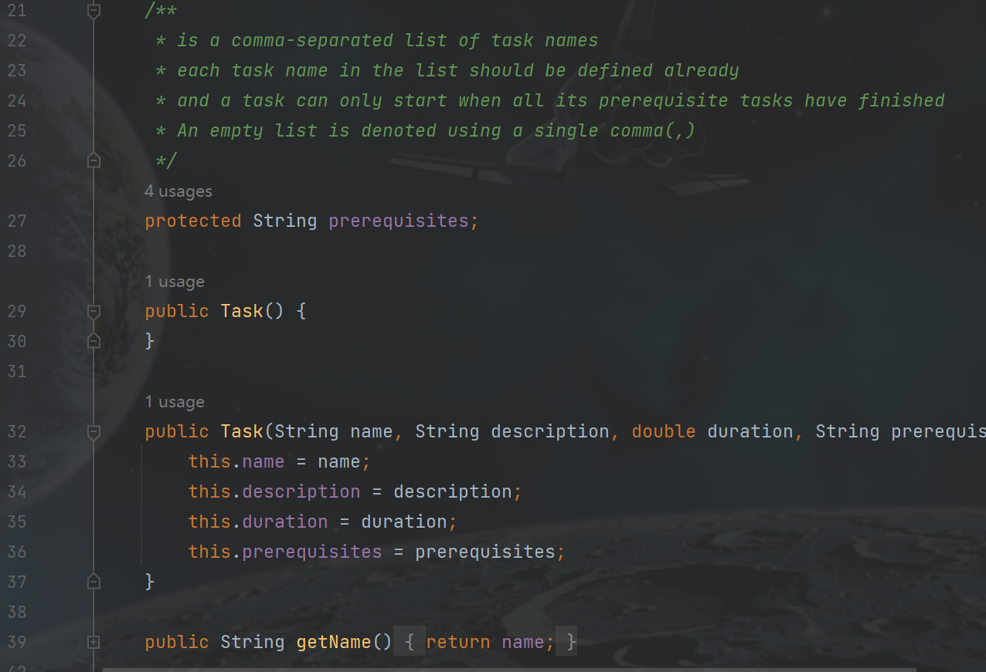
Model class

Slide 5


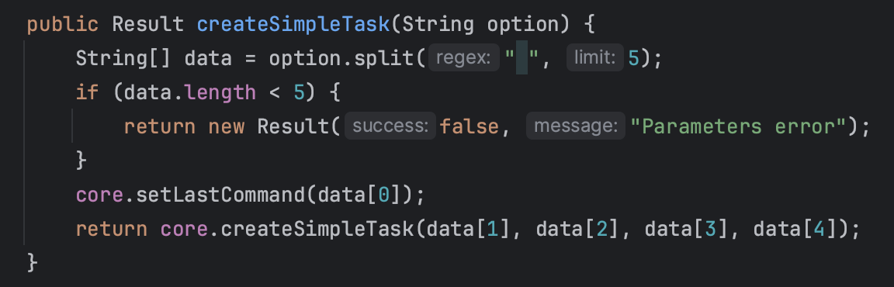
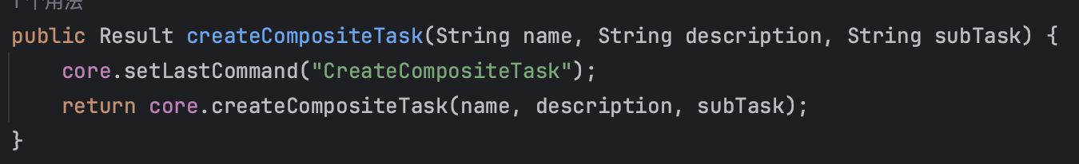
Controller Class function
Option is the string that contains all the parameters
We split the parameters and call the corresponding method
The commandController is responsible for interpreting and executing commands related to task operation.
The uicontroller handles the user interface part of the application. It's responsible for displaying information to the user and interpreting user input to execute the operation.

Slide 6
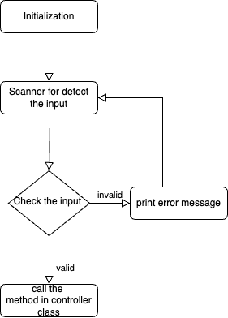
View class overview
Main class (CLI)
It contains two methods: getmenu() and gethelp()
Mainui class (gui)
There are lots of gui elements, the key elements: home panel, menue panel

Slide 7
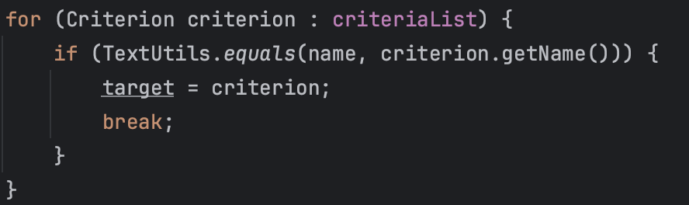
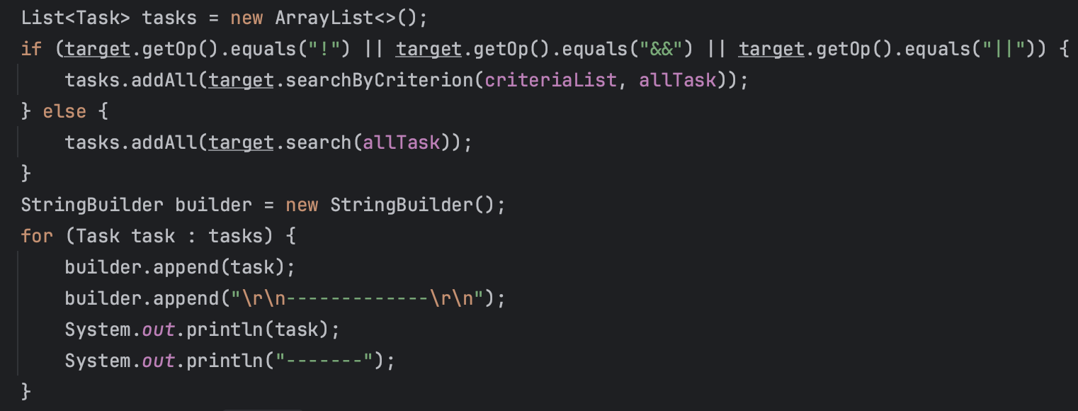
Key funtionality implementation
REQ 13 search name
We search the target criterion from the criterion list.
Then we get the operator of the criteria and use the search by criteria method which defined at criterion class to search the tasks which satisfy the criteria. We append the tasks to string builder and print them out

Slide 8
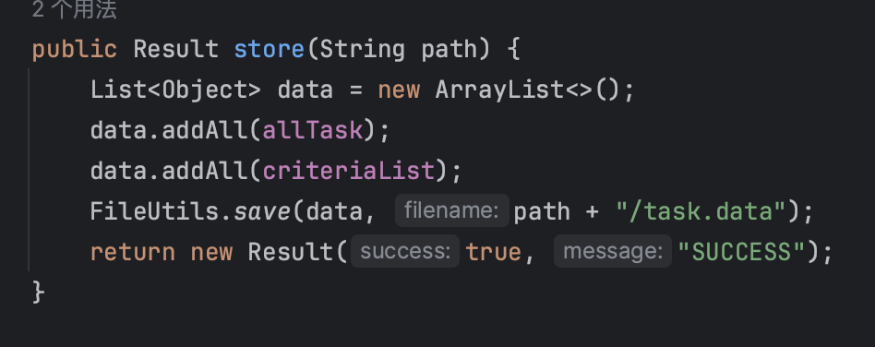
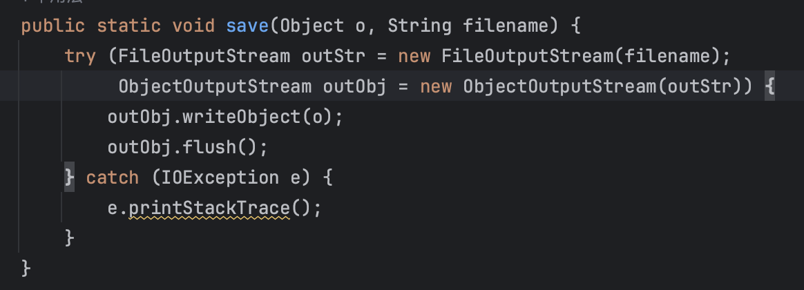
Key FUNTIONALITY implementation
Req 14 store
We add all the tasks and criterion into a list called data
We use the save method in fileutils class. The method serializes an object and save it into a file

Slide 9
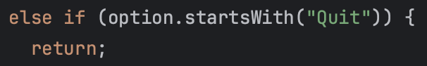
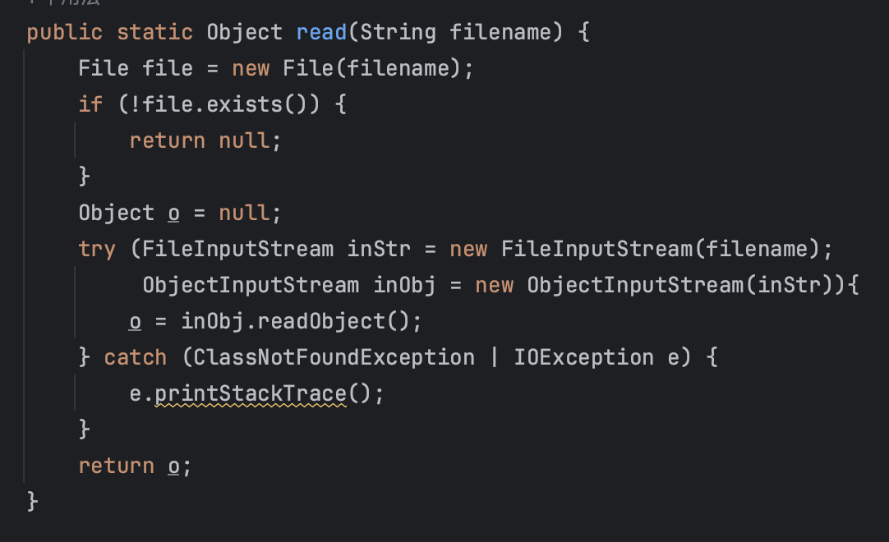
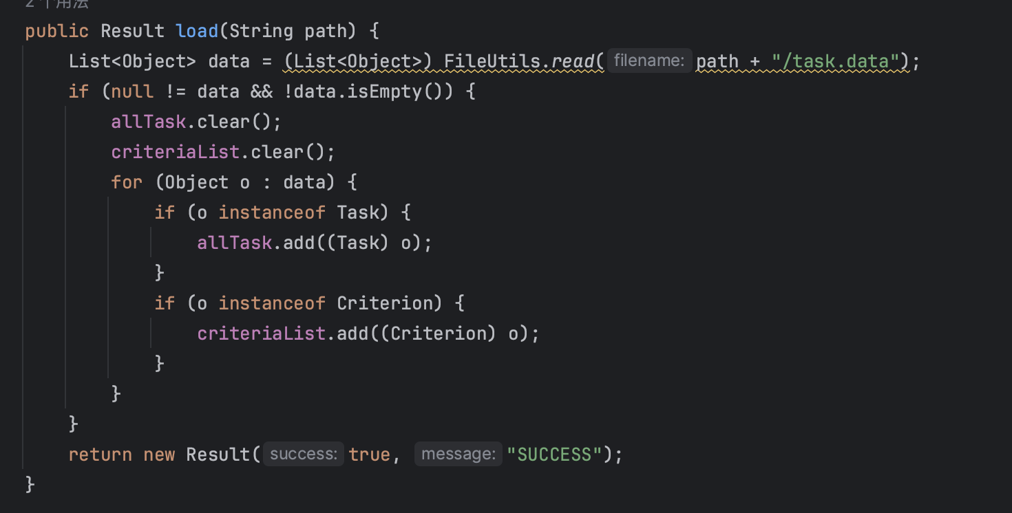
KEY FUNTIONALITY IMPLEMENTATION
REQ 15 load
We usr the read method in fileutils class to read the data in the file and save it to a list called data
Then we check the property of the data. If it belongs to task class, then we add it to the task list, else add it to the criterion list
The read method reads a serialized object from a file and deserializes it
REQ 16 quit
If the scanner detected input is quit, we return in the main class which ends the application

Slide 10

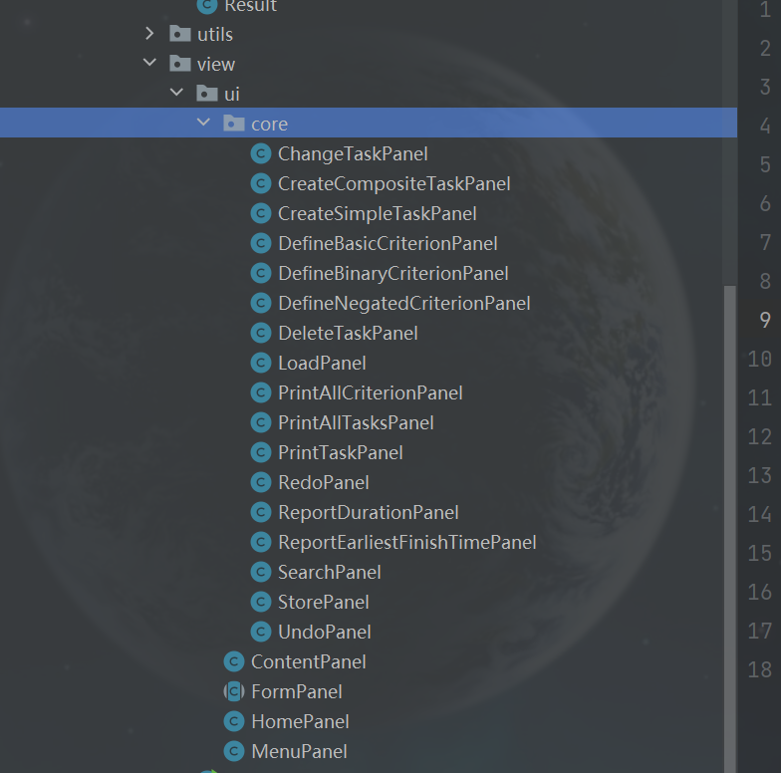
GUI Design and Object-Oriented Principles

Slide 11
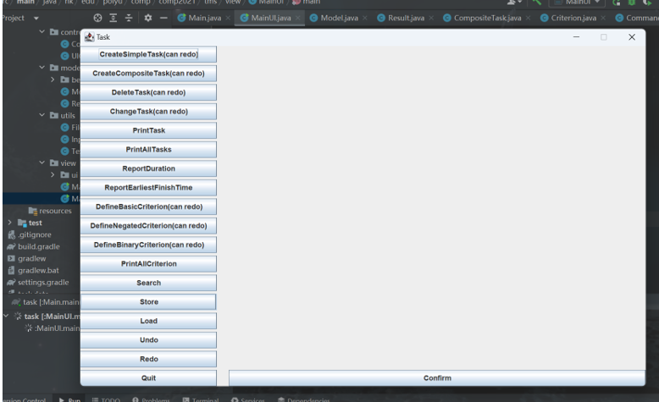
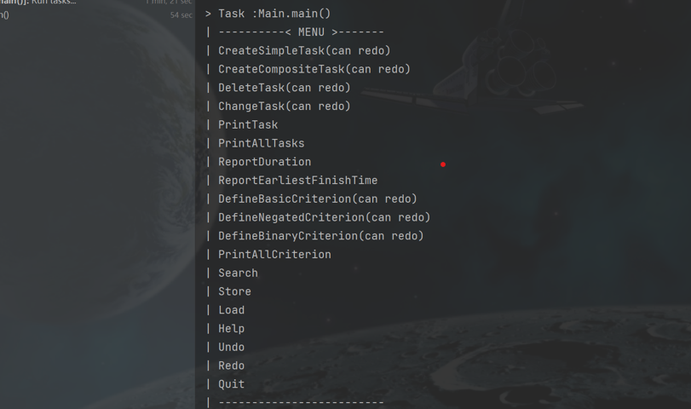
CLI AND GUI DESIGN

Slide 12

Bonus Features - Undo/Redo

Slide 13
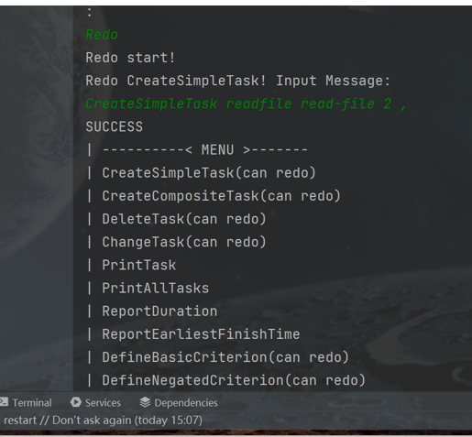

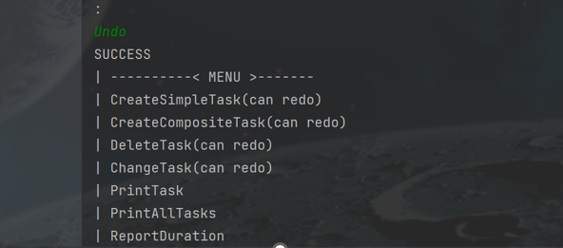
CLI AND REDO/UND UNDO

Slide 14
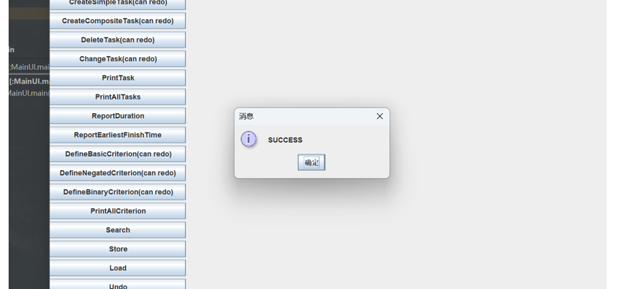
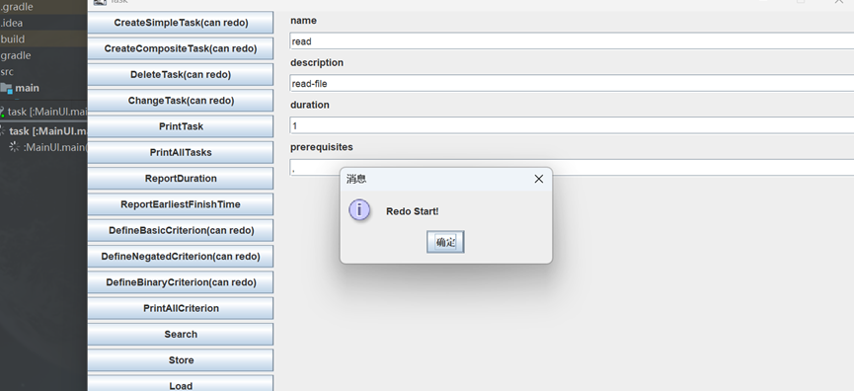
GUI REDO/UNDO

Slide 15
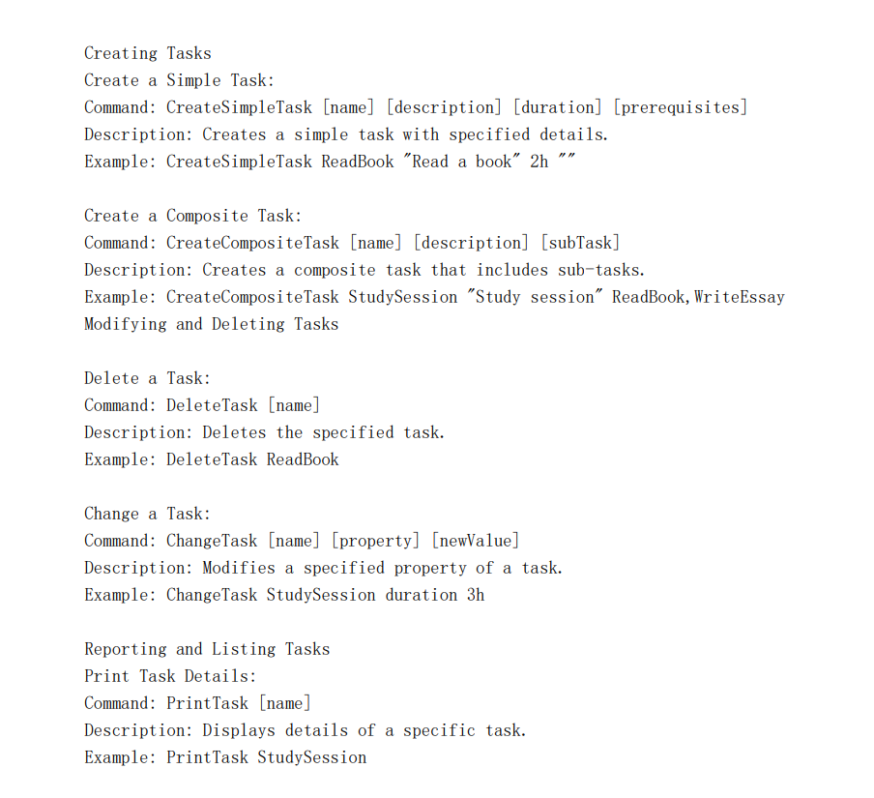
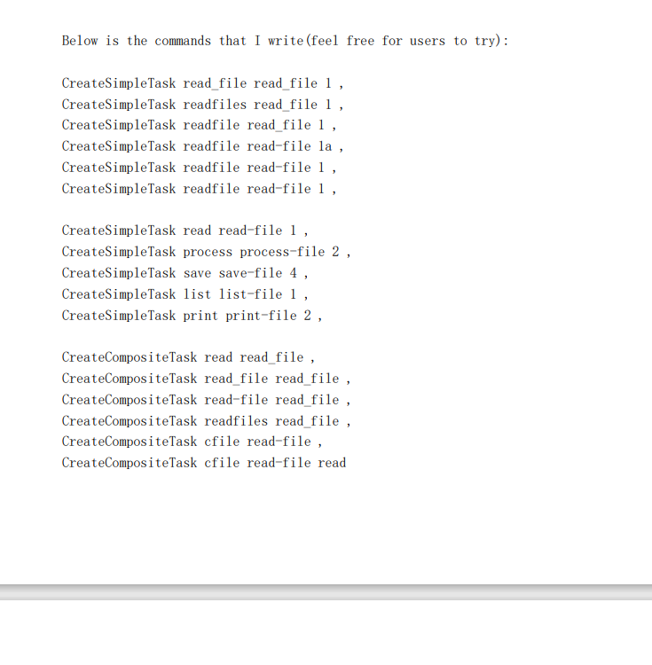
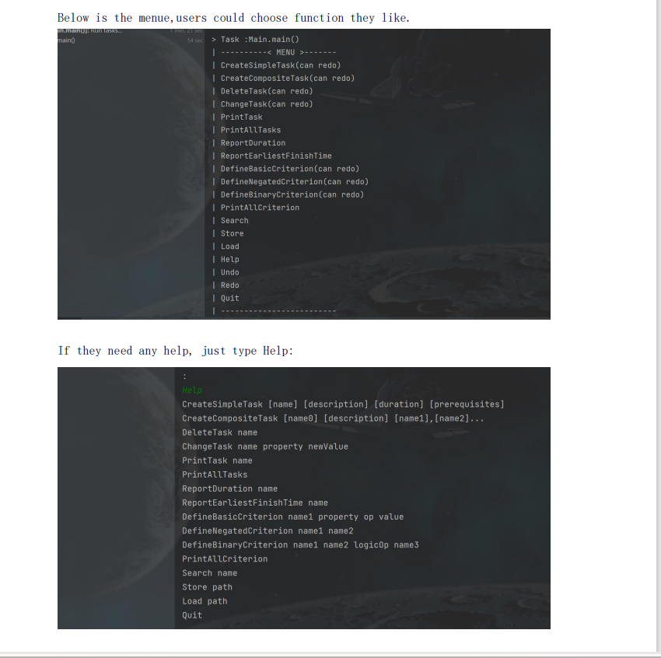
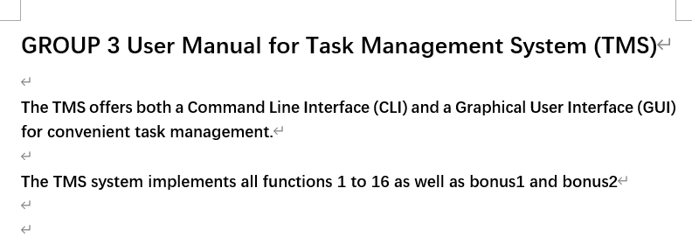
User hand book

Slide 16
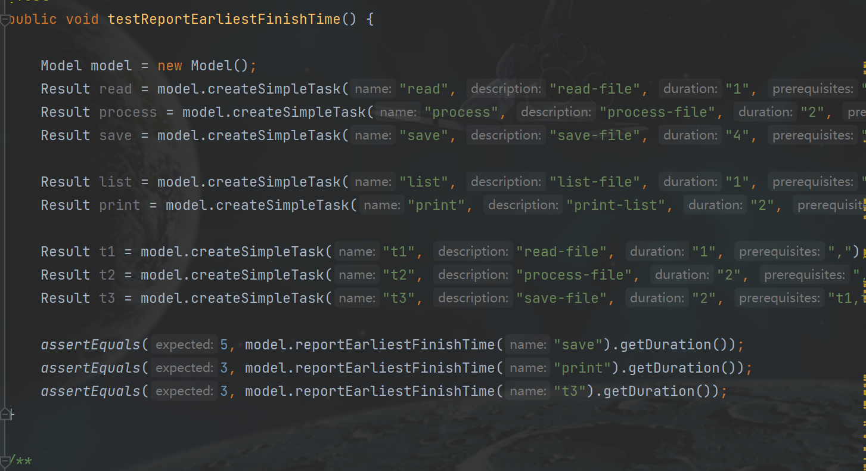
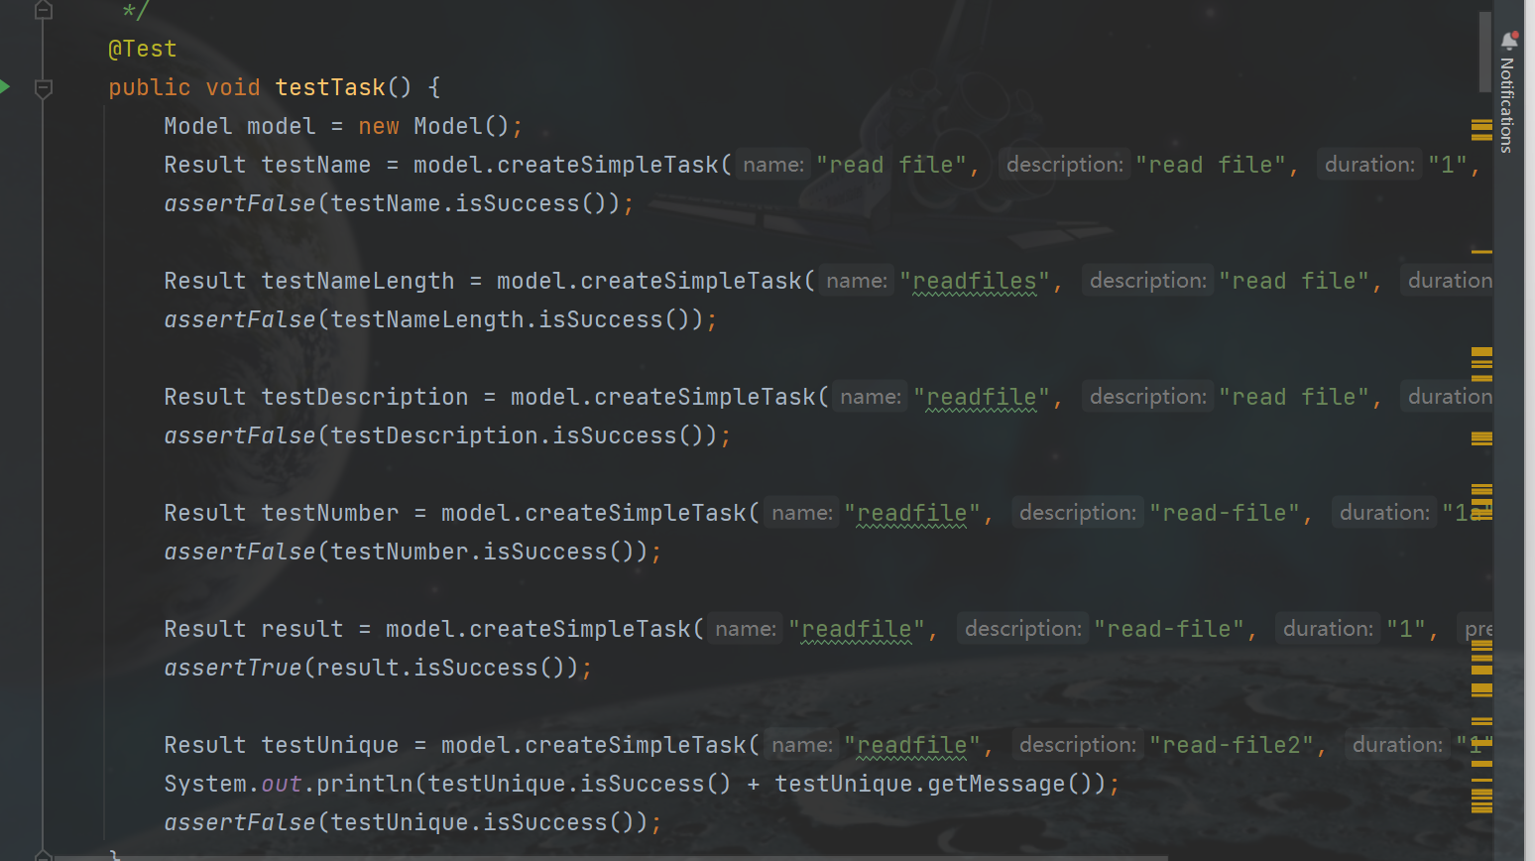
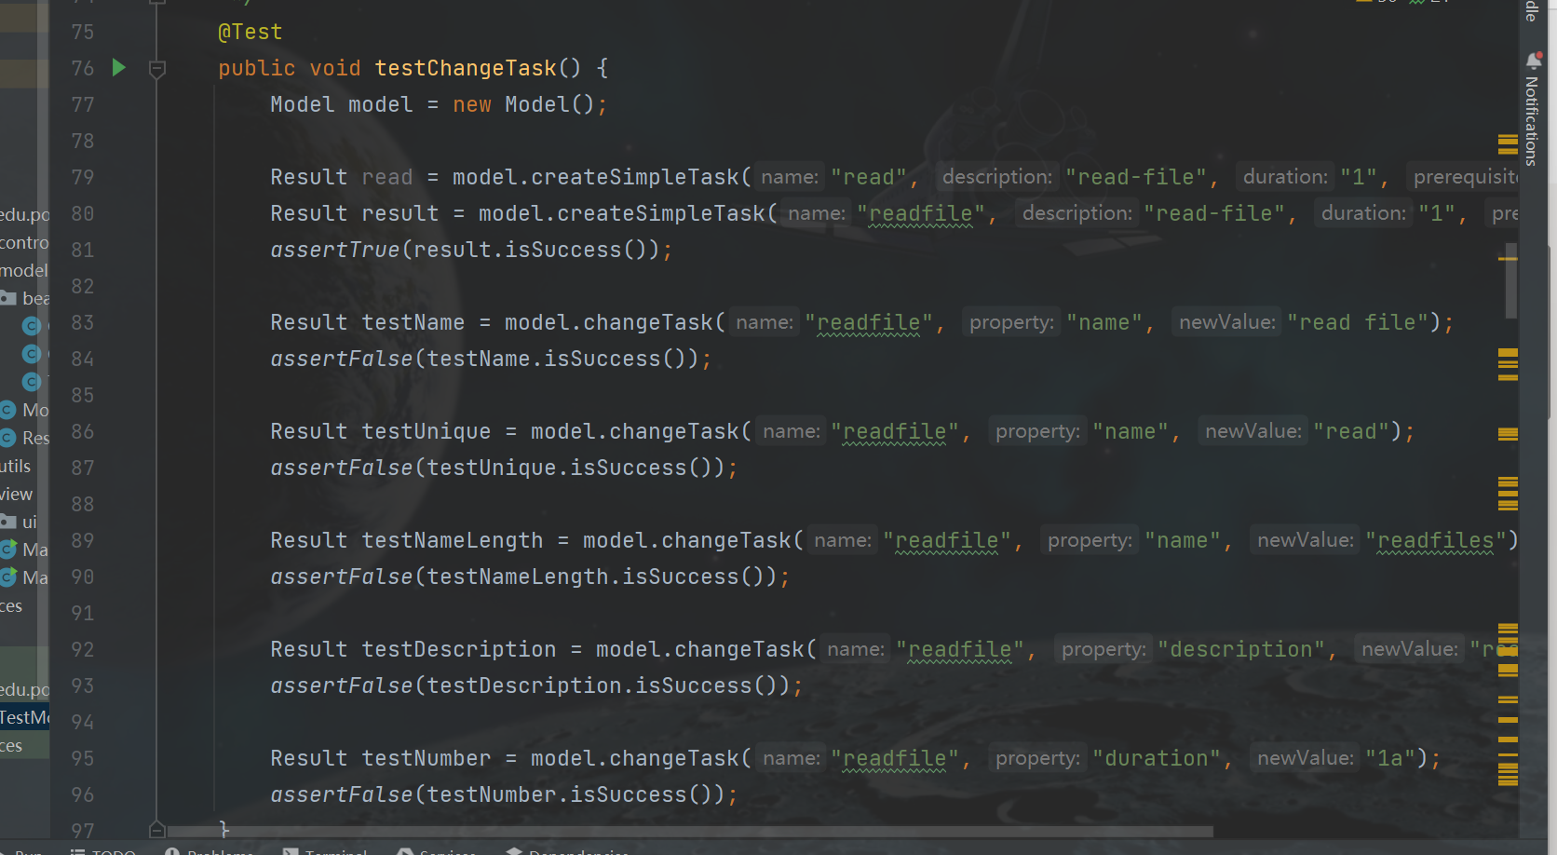
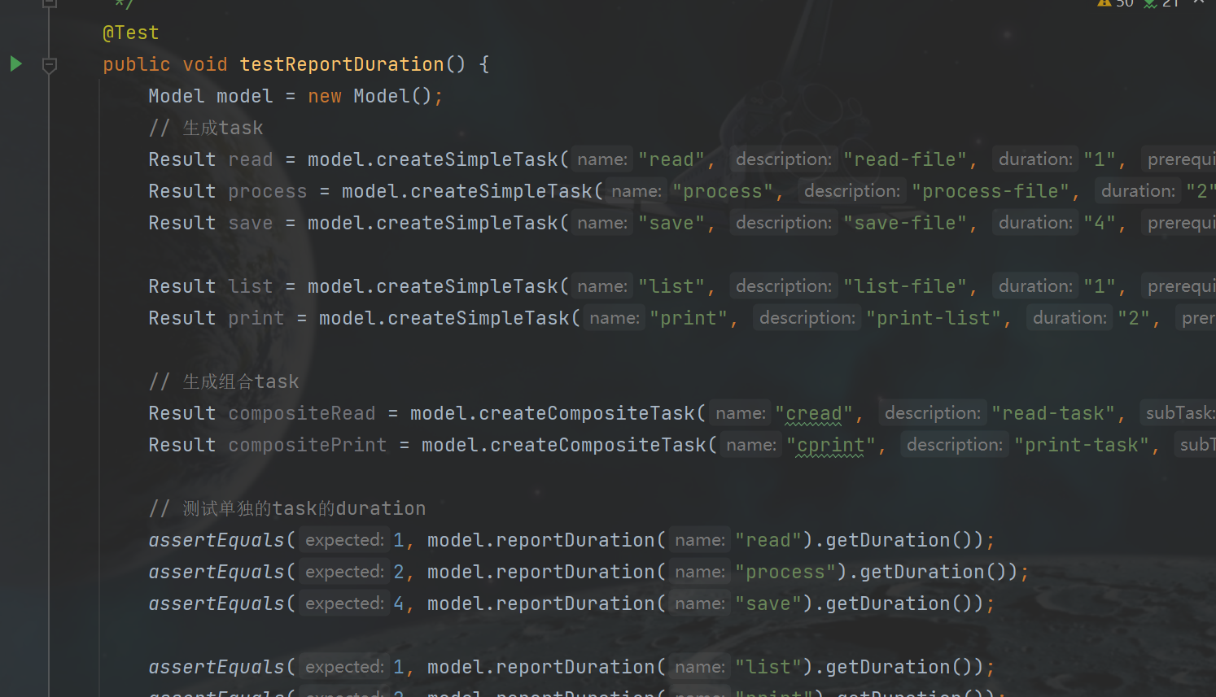

Slide 17
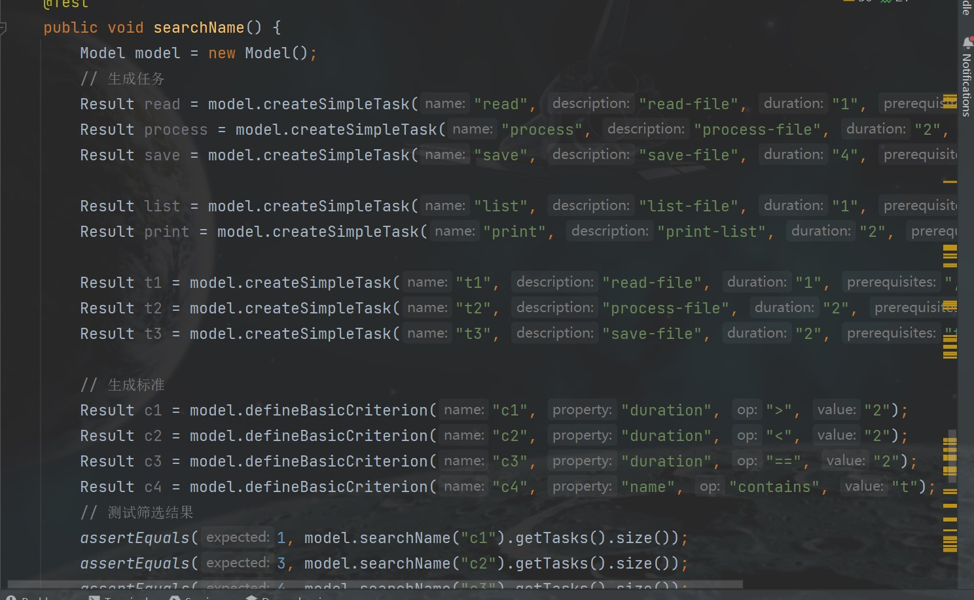
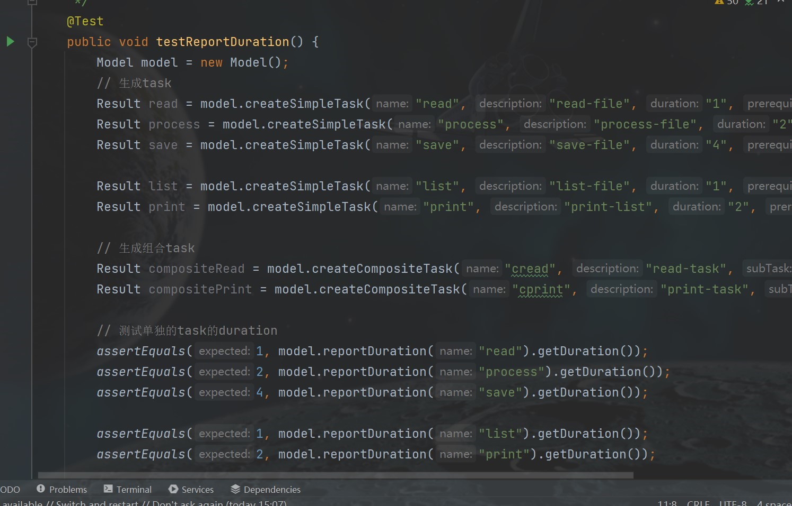
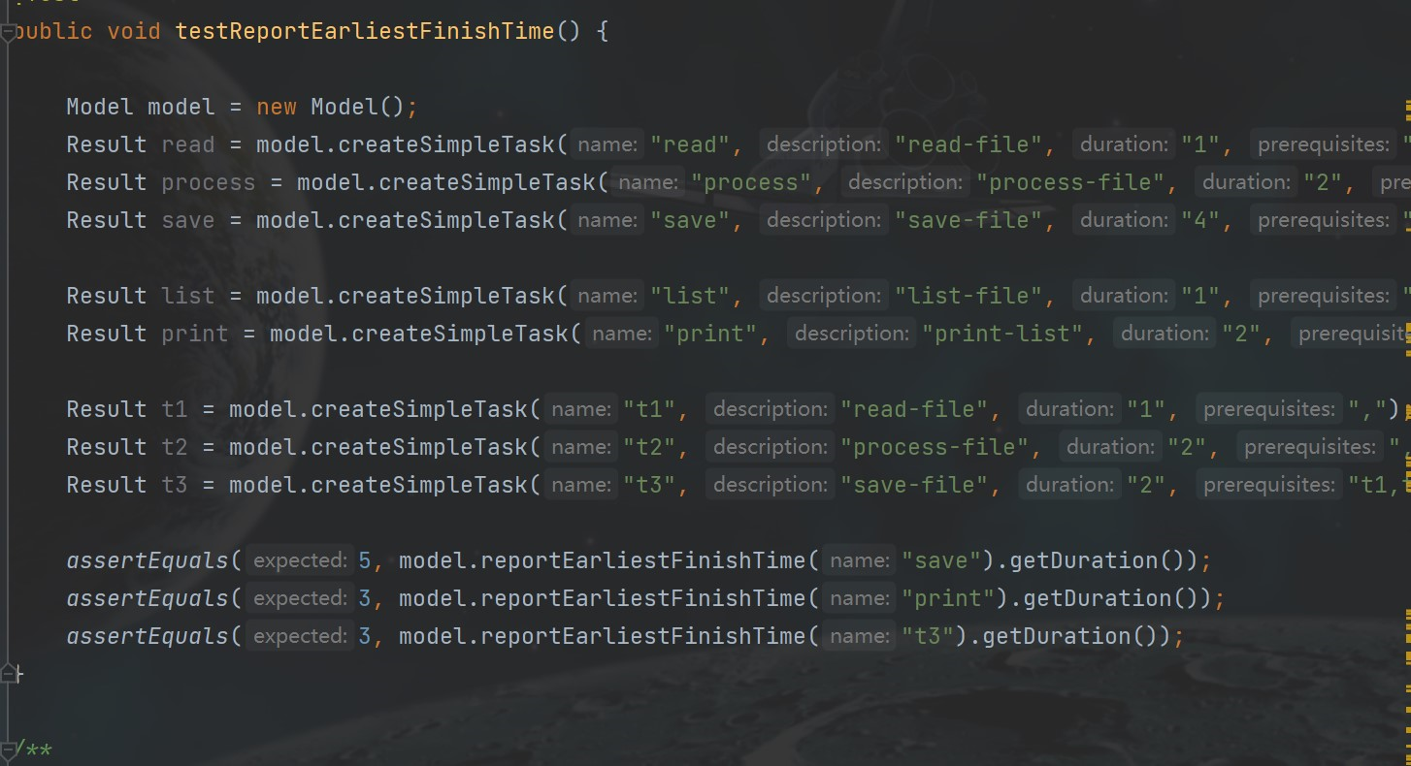
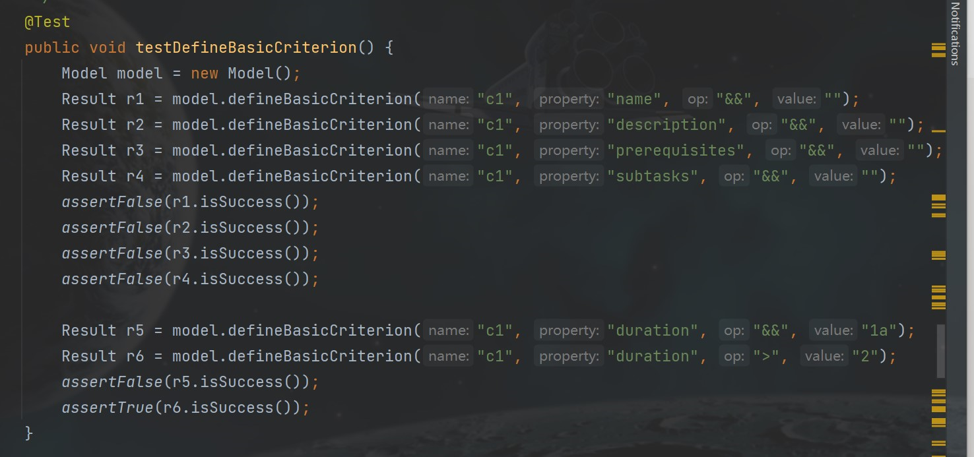

Slide 18
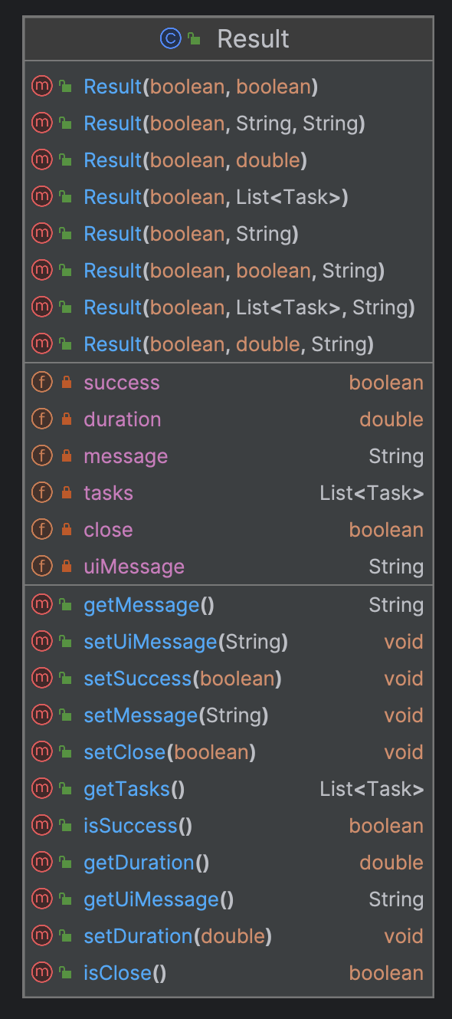
Challenges and learning
Challenge 1: handling users’ input errors can be complicated for this project
Solution: encapsulate the execution result in a ’result’ object
Advantage:
Easier to propagate and handle errors between different components of the system
consistent and maintainable
Easy testing

Slide 19
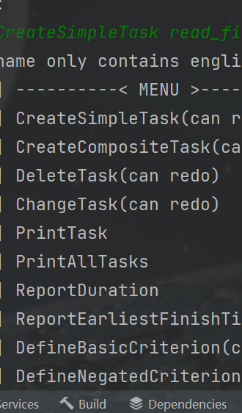
Challenges and learning
Challenge 2: improve the ux (user experience)
Solution: put ourselves in the shoes of the user, do testing
provide a menu of commands
Include a ‘help’ command that shows more clear instructions to the users
i.e. CreateSimpleTask [name] [description] [duration] [prerequisites]
make sure error messages are concise and accurate
i.e. the name should be unique!

Slide 20
Conclusion: Challenges and learning
Grasped a Deeper understanding of the object-oriented programming:
Significance of optimizing design patterns
Significance of encapsulation to code maintainability
Significance of good uX (user experience) design

Slide 21

Thank you! ☺

Slide 22

Q&A TIME~

